Slide 1
OSI model
Presented by
Dmitro Malikov

Slide 2
The OSI Model:
International standard organization (ISO) established a committee in 1977 to develop an architecture for systems communication.
Open System Interconnection (OSI) reference model is the result of this effort.
This model allows any two different systems to communicate regardless of their underlying architecture.

Slide 3
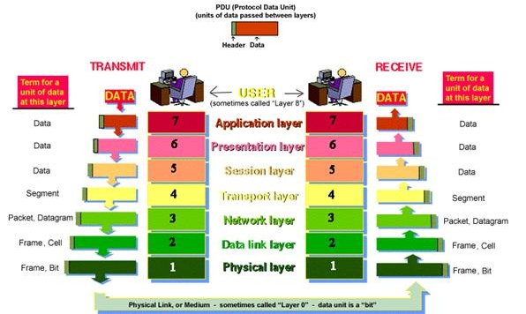
Seven layers of the OSI model:

Slide 4
Why so many layers?
To reduce the complexity, networks are organized as a stack of layers, one below the other.
Each layer performs a specific task,. It provides services to an adjacent layer.

Slide 5

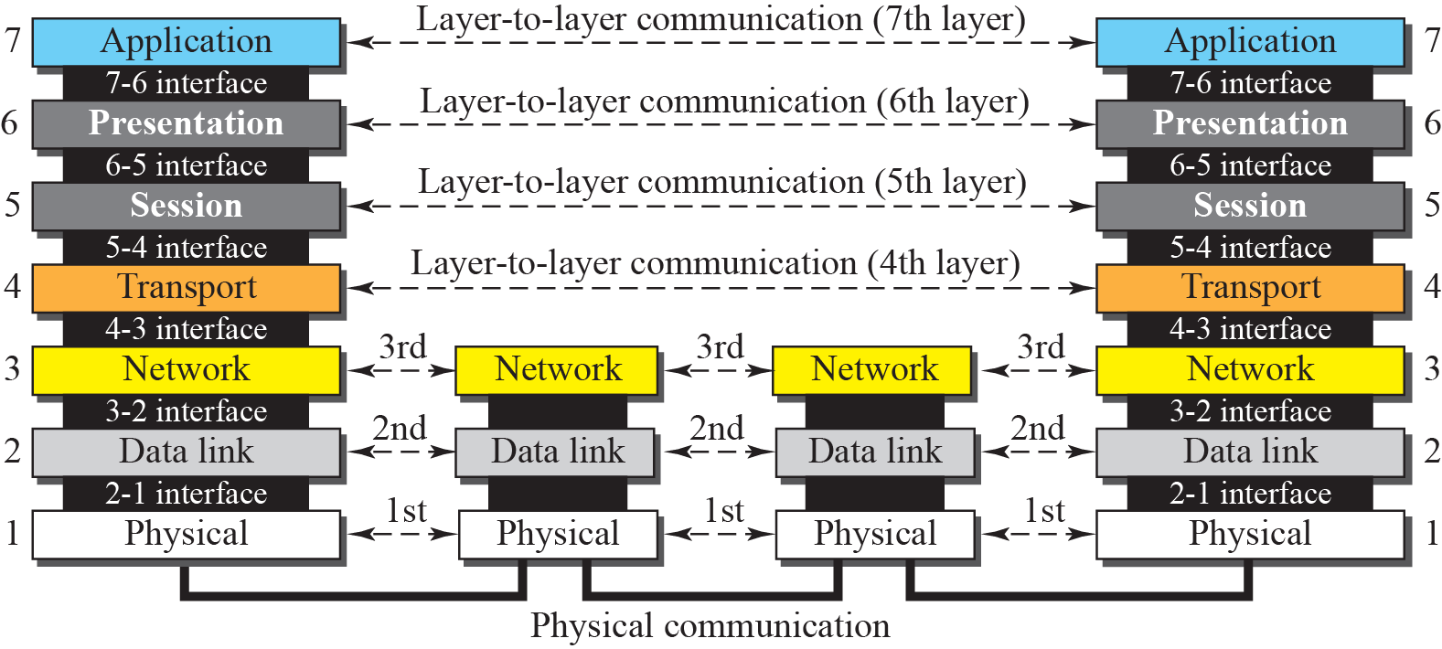
OSI Layers:

Slide 6
OSI Layers
Layers 1,2, 3- physical, data link and network are network support layers.
Layer 4, the transport layer, links the two subgroups.
Layers 5,6,7- session, presentation, and application are user support layers.

Slide 7
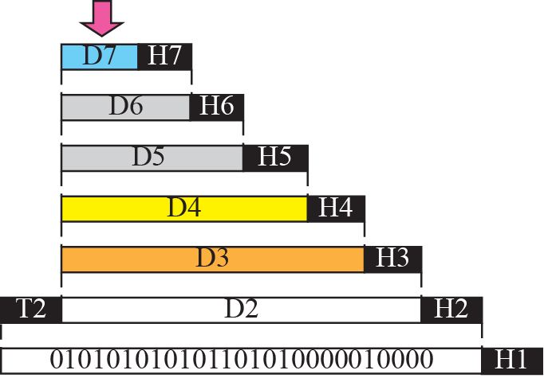


An exchange using the OSI model:

Slide 8
Physical Layer:
Physical layer is the bottom(layer 1) of OSI model.
It is responsible for the actual physical connection between the devices.
The physical layer is responsible for movements of individual bits from one node to next.

Slide 9
Physical layer

Slide 10
Functions of Physical Layer:
Convert bits to signals
Bit synchronization
Manage physical connection
Bit rate control
Line configuration
Physical topology
Transmission mode
Multiplexing
Switching

Slide 11
Data Link Layer:
The data link layer is responsible for moving frames from one node to the next.

Slide 12
Functions of Data Link Layer:
Framing:- divides the data from N/W layer into frames.
Physical Addressing:- Add a header to the frame to define the physical address of the source and the destination machines.
Flow Control:- It is the traffic regulatory mechanism implemented by Data Link layer that prevents the fast sender from drowning the slow receiver.
Error Control:- It provides the mechanism of error control in which it detects and retransmits damaged or lost frames.
Feedback:- after transmitting the frames, the system waits for the feedback.

Slide 13
Network Layer:

Slide 14
Functions of Network layer:
It is responsible for the source to destination delivery of a packets across multiple networks.
Routing:- Provide mechanism to transmit data over independent networks that are linked together.
Logical addressing:- Adds Logical addresses of sender and Receiver.

Slide 15
Transport Layer:
It is responsible for source process to destination process delivery of entire message.

Slide 16
Transport Layer
Transport layer provides two types of services:
Connection Oriented Transmission: In this type of transmission the receiving device sends an acknowledgment back to the source after a packet or group of packet is received.
Connectionless Transmission: In this type of transmission the receiver does not acknowledge receipt of a packet.

Slide 17
Functions of Transport Layer:
Segmentation and Reassembly: Divide the message received from Session layer into Segments and number them to make a sequence for reassembly at the receiving side.
Service point addressing: Transport layer makes sure that the message is delivered to the correct process on destination machine.
Error Control: Make sure that the entire message arrives without errors else retransmit.
Flow Control: Transport layer makes sure that the sender and the receiver communicate at a rate they both can handle.

Slide 18
Session Layer:
It is responsible for beginning, maintaining & ending the communication between two devices, which is called session.

Slide 19
Functions of Session Layer:
Establishment, maintaining and ending a session:
Sends SYN packet – establish request
Receives ACK & SYN- established
To end – Sender sends ACK
Dialog Control: The session layer allows two systems to enter into a dialog.
Synchronization: Allows a process to add checkpoints to a stream of data.

Slide 20
Presentation Layer:
This layer is concerned with the syntax and semantics of the information exchanged between two systems.

Slide 21
Functions of Presentation Layer:
Data Translation: Encoding and Decoding
Sender to Common format on Sending side
Common to Receiving format on Receiver side
Data Encryption: For security and privacy purpose.
Data Compression: Data compression reduces the number of bits contained in the information.

Slide 22
Application Layer:
Provides User interfaces and support for Services, like e-mail, file transfer.

Slide 23
Functions of Application Layer:
Network Virtual terminal: It allows a user to log on to a remote host.
File Transfer Access, and Management: This application allows a user to access files in a remote host.
Mail Services: This application provides various e-mail services.
Directory Services: This application provides the distributed database sources and access for global information about various objects and services.

Slide 24
The end

